Slide 1



Inspiring projects from BARANYA country

Slide 2
Station
Pécs – 145.000 people
Sásd – 3.000 people
Feked – 200 people

Slide 3
pécs
History:
SEAP - 2011: -20 emissions of harmful substances
20% kibocsátás → OK.
SECAP – 2021 – - 47,4% -20 emissions of harmful substances by 2030.

Slide 4
climate neutrality vision
Energy-Saffety
Energy efficiency measures in the building stock (10-15%)
increasing the role of the hydrogen economy
Protecting and increasing green spaces

Slide 5

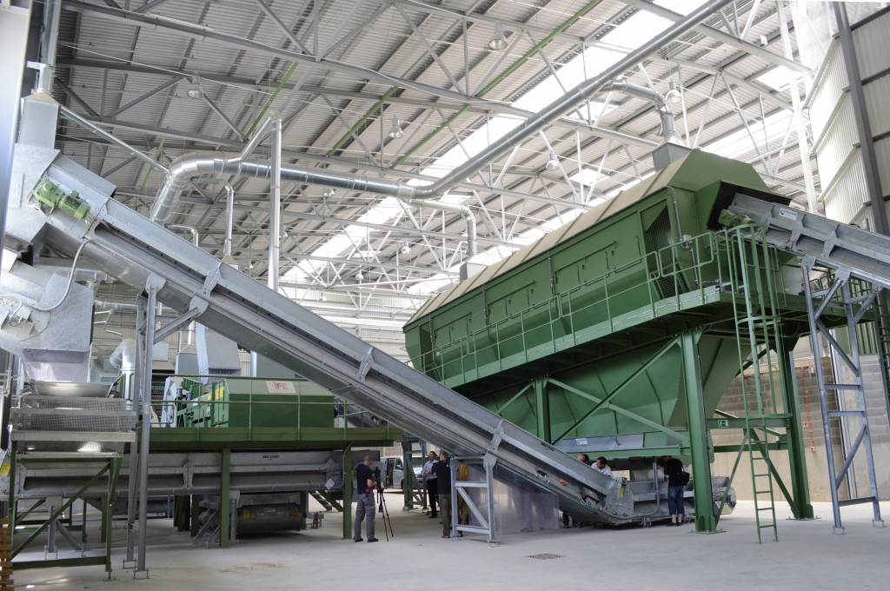
Results
Solar Park - 12 GWh/year (2022)
renovated sewage plant
More selective waste collectors
18 e-bus
University in Pécs is the most green university is Hungary

Slide 6
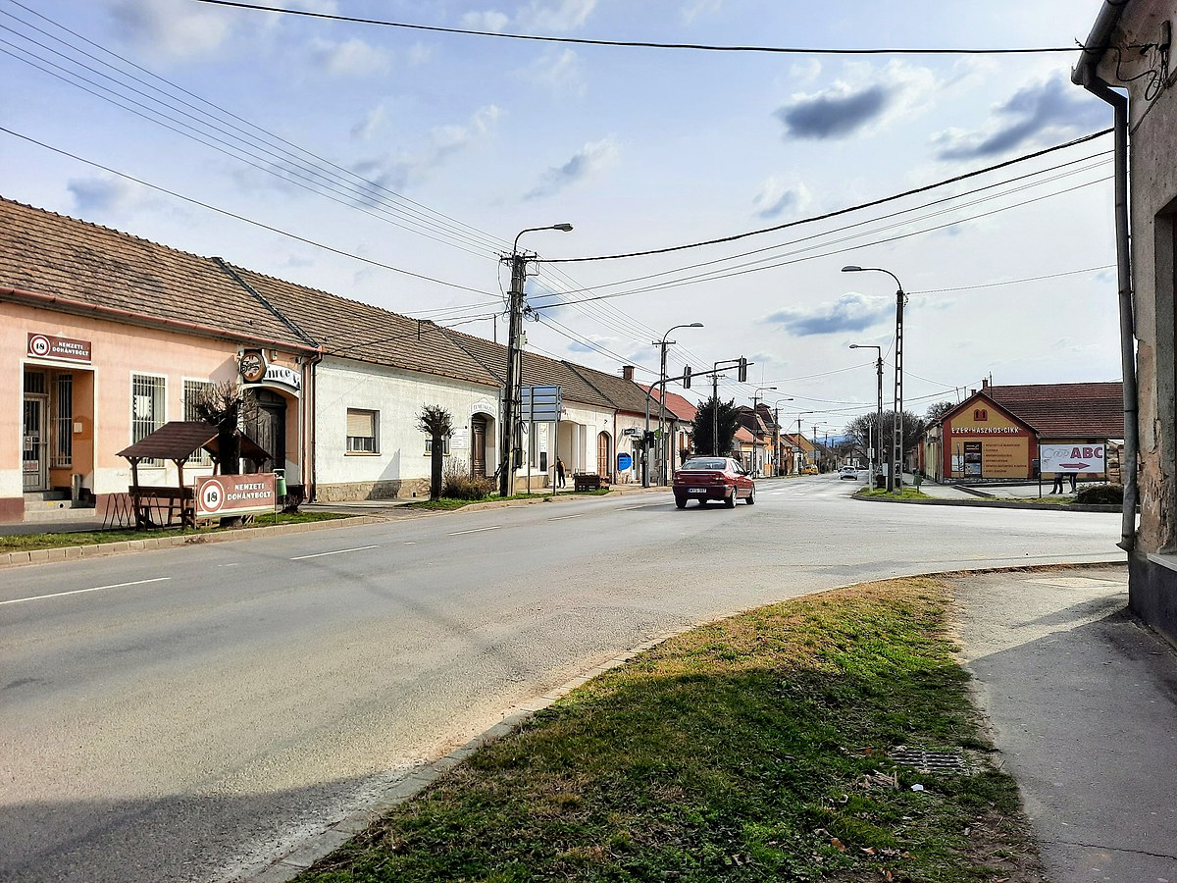
Sásd – energy Modernisation of social house

Slide 7
Problems
Bad energy indicators
Obsolate insulation
Bad heating technology
TOP-3.2.1-15-BA1-2016-00008 → 81 963 706 Huf →Za. 220.000 EUR

Slide 8
results
Solar energy: 146.9 Gj/year
Energy-saving: 159 794,97 kw/year
Minus 41.63 t CO2

Slide 9
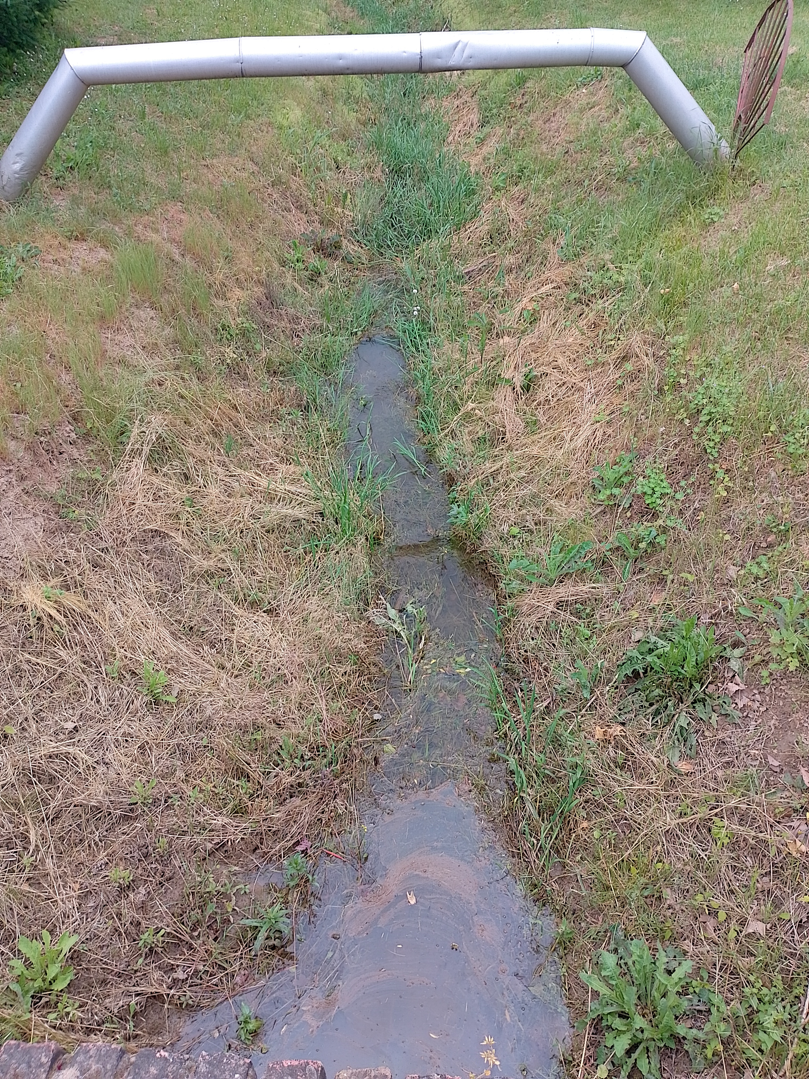
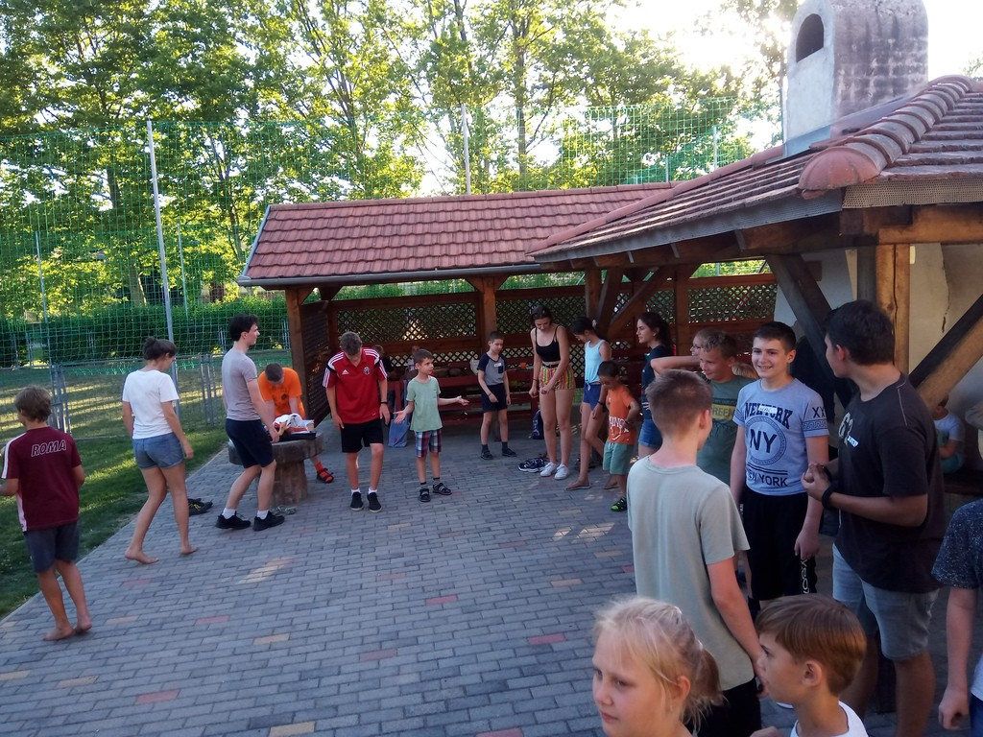
Feked - sewerage and sewage treatment - 282 247 627 Ft → 753.000 EUR
Feked Község szennyvízcsatornázása és szennyvíztisztítása

Slide 10


Thank you for attention

